Slide 1
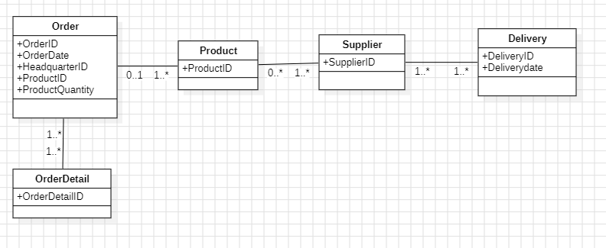
Delivery(DeliveryId, DeliveryDate)
Supplier(SupplierId)
Product(ProductId)
Order(OrderId, OrderDate, HeadquarterID, ProductId, ProductQuantity)
OrderDetail(OrderDetailID)
Assign(#OrderId, #DeliveryId)

